Slide 1

Project Title -
Seasonal Agriculture Performance Analysis
AICTE STU ID : STU6a6b6aaf9aba31785424559
[Jode Srija ]

Slide 2

PROBLEM STATEMENT
Agricultural activities are influenced by seasonal variations in environmental conditions, farming practices, resource availability and market conditions. As a result, agricultural performance may differ from one season to another. However, raw agricultural data does not clearly explain how agricultural performance changes across seasons or what patterns can be observed in different seasonal conditions. The problem is to analyze the given agricultural dataset and investigate seasonal differences in agricultural performance by identifying meaningful patterns, trends, relationships and variations within the available data

Slide 3
Project Description
Seasonal Agriculture Performance Analysis – Description
Seasonal Agriculture Performance Analysis is the study of agricultural production and crop performance across different seasons. It analyzes factors such as crop yield, rainfall, temperature, soil conditions, irrigation, and seasonal variations to understand their impact on agricultural productivity. The analysis helps farmers and agricultural planners identify high-performing crops, suitable growing seasons, production trends, and areas for improvement. Data visualization techniques such as bar charts, line graphs, and pie charts can be used to clearly present the results and support better decision-making.

Slide 4

WHO ARE THE END USERS?
👨‍🌾 Farmers – To understand crop performance and choose suitable crops and seasons.
🏢 Agricultural Departments – To monitor agricultural production and seasonal trends.
🔬 Agricultural Researchers – To analyze crop, weather, and yield patterns.
📊 Agricultural Analysts – To study data and generate useful insights.
🌱 Agribusiness Companies – To support crop planning and resource management.
🏦 Government & Policy Makers – To make better agricultural policies and decisions.

Slide 5

Technology Used
python – Data analysis and processing
Pandas – Data cleaning and manipulation
NumPy – Numerical calculations
Matplotlib & Seaborn – Data visualization
Jupyter Notebook – Development and analysis environment
Excel / CSV – Dataset storage and management
Machine Learning – Crop performance and seasonal trend analysis

Slide 6
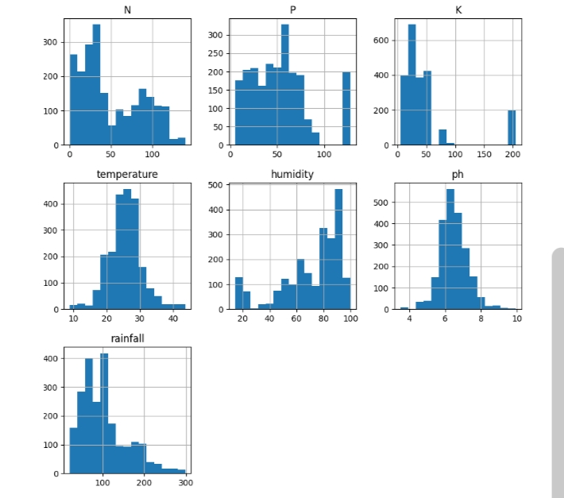
RESULTS
Demo Link

Slide 7
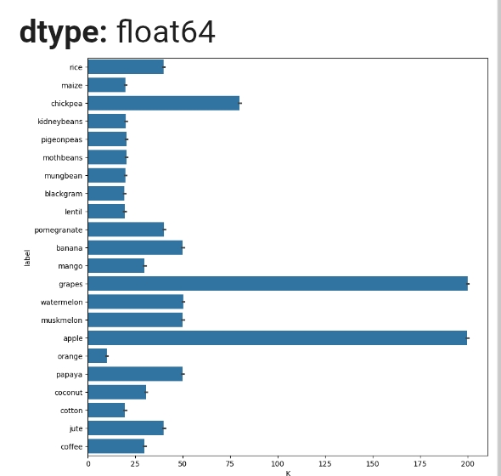
RESULTS
Demo Link

Slide 8
Thank you
🌱 Seasonal Agriculture Performance Analysis
.
.

